Slide 1
Cuckoo search algorithm

Slide 2

Cuckoo search algorithm (History and main idea)
A method of global optimization based on the behavior of cuckoos was proposed by Yang & Deb (2009).
The standard “cuckoo search (CS) algorithm” is based on the idea of the following :-
How cuckoos lay their eggs in the host nests.
How, if not detected and destroyed, the eggs are hatched(to produce (young) from an egg) to chicks by the hosts.
How a search algorithm based on such a scheme can be used to find the global optimum of a function.

Slide 3
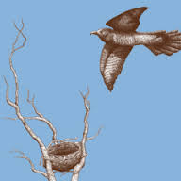
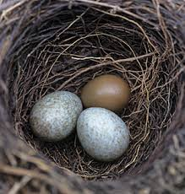
Characteristics of Cuckoo search
Each egg in a nest represents a solution, and a cuckoo egg represents a new solution.
The aim is to employ the new and potentially better solutions (cuckoos) to replace not-so-good solutions in the nests.
In the simplest form, each nest has one egg.
The algorithm can be extended to more
complicated cases in which each nest has multiple eggs representing a set of solutions.

Slide 4
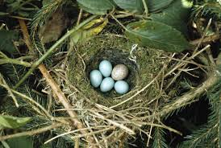
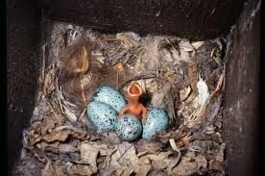
Characteristics of Cuckoo search (cont)
The CS is based on three idealized rules:
• Each cuckoo lays one egg at a time, and dumps it in a randomly chosen nest.
• The best nests with high quality of eggs (solutions) will carry over to the next generations.
• The number of available host nests is fixed, and a host can discover an alien egg with probability p ϵ [0,1] .
In this case, the host bird can either throw the egg away or abandon the nest to build a completely new nest in a new location.

Slide 5
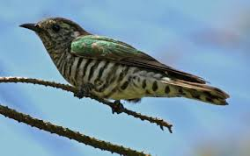
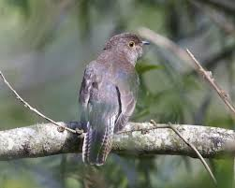

Lѐvy Flights
A Lévy flight is a random walk in which the step-lengths are distributed according to a probability distribution.
After a large number of steps, the distance from the origin of the random walk tends to a stable distribution.
When generating new solutions x^{(t+1)} for, a cuckoo i, a L´evy flight is performed.
where S_{L} is a vector drawn from the Levy distribution and α > 0 is the step size scaling factor, which should be related to the scales of the problem of interest.

Slide 6

Lѐvy Flights (Cont.)
Next status/location only depends on the current location (the first term in the above equation) and the transition probability (the second term).
Many algorithms exist for generating Levy flights in the literature, but Mantegna's algorithm works very well as compared to others. In this algorithm, the step length s can be calculated by:
where u and v are drawn from normal distributions and λ=[0.3, 1.9]

Slide 7

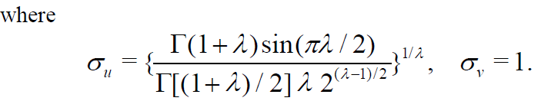
Lѐvy Flights (Cont.)
This algorithm will generate samples that obey the expected Levy distribution for s>s0 where s0 is the smallest step. In theory, s0>>0, but in practice, s0 can be taken as a small value such as s0 =0.1.

Slide 8
Cuckoo search Algorithm
The following steps describe the main concepts of Cuckoo
search algorithm.
Step1. Generate initial population of n host nests.
Initial Population
Individual | Dimension of each individual
Nest 1 | a1 | r1 | .. s1j
Nest 2 | a2 | r2 | ...s2j
Nest k | ak | rk | ..skj

Slide 9
Cuckoo search Algorithm (Cont)
Step2. Compute Fitness of each individual.
Step3. Generate a new solution X_{i}^{(t+1)} for cuckoo using levy flight.
Where position or optimal parameter for new solution X_{i}^{(t+1)} is computed by using following formula.
𝑎𝑘′=𝑎𝑘+𝑅𝑎𝑛𝑑𝑜𝑚𝑤𝑎𝑙𝑘(Lѐvy flight)𝑎𝑘
𝑟𝑘′=𝑟𝑘+𝑅𝑎𝑛𝑑𝑜𝑚𝑤𝑎𝑙𝑘(Lѐvy flight)𝑟𝑘

Slide 10
Cuckoo search Algorithm (Cont)
Step4. Compare the fitness of individual generated by levy flight with randomly selected individual from previous population.
Step4. If the fitness of individual generated by levy flight (cuckoo’s solution) is better than host , replace the individual (optimal parameter) in nest k by cuckoo’s optimal parameter .
Step5. A Fraction of worse nests are discovered with a probability pa. Generate a random probability(0<pr<1) for each dimensions of each individual and if pr> pa, abandoned that nest and built new one . (to avoid local optimization)

Slide 11
Cuckoo search Algorithm (Cont)
New nest is built using biased random walk.
stepsize=rand*(X_{j}^{(t)} - X_{k}^{(t)});
Where X_{j}^{(t)} and X_{k}^{(t)} are two different solution selected by random permutation.
X_{i}^{(t+1)} = X_{i}^{(t)} + stepsize* K
where K is a random generated value in the range of 0 to 1 and should be greater than pa.
Step6. Compare the fitness of each individual of new solution by randomly selected individual’s fitness and find the quality solution.
Iterate steps 2 to 6 until termination criterion satisfied

Slide 12
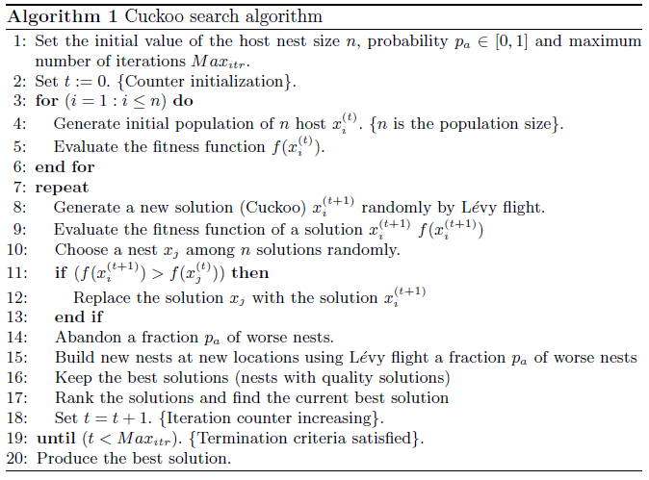
Cuckoo search Algorithm

Slide 13
Application of the CS Algorithm
Engineering optimization problems
NP hard combinatorial optimization problems
Data fusion in wireless sensor networks
Train neural network
Manufacturing scheduling

Slide 14
References
1. Xin-She Yang, Nature-Inspired Optimization Algorithms, Elsevier, (2014).
2. Xin-She Yang, Cuckoo Search and Firefly Algorithm: Theory and Applications, Springer, (2013).
3. Xin-She Yang and Suash Deb, Multi-objective cuckoo search for design optimization, Computers & Operations Research, 40(6), 1616–1624 (2013).
4. http://en.wikipedia.org/wiki/Cuckoo_search
5. The Use of Cuckoo Search in Estimating the Parameters of Software Reliability Growth Models 2013. 8. 7 Taehyoun Kim.
6. Dr. Ahmed Fouad Ali, Cuckoo search algorithm, www.slideshare.net/ Ahmed Fouad /cuckoo-search-algorithm.

Slide 15
Thank you

